Slide 1
Explore the Data: Descriptive Statistics
Overall Findings

Slide 2
Data description Size of the data set: 270, 9 rows and 30 coloumn. It consists of marks of 30 students of three subjects from different cities.

Slide 3
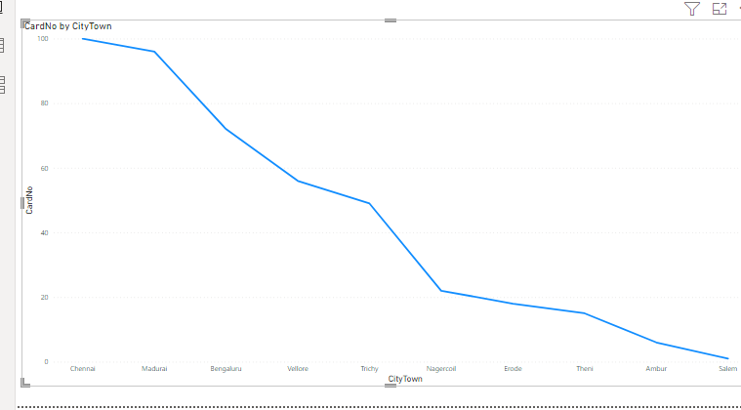
1. Where do most of the students come from?
most of student come from: Chennai

Slide 4
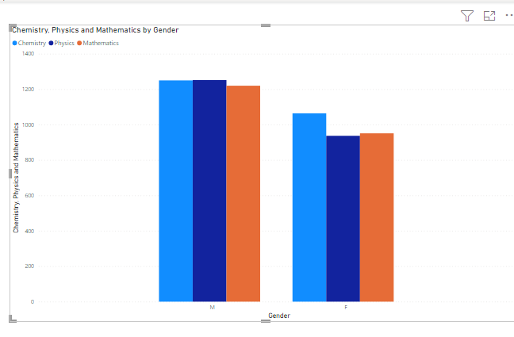
2. Did marks obtained by students change with their gender: yes As we can see in graph below male students scored more marks in every subject than female student.

Slide 5
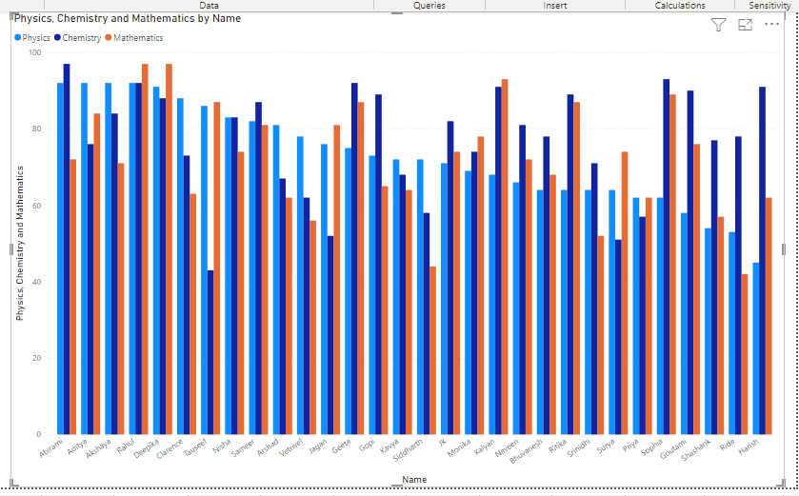
3. What is the pattern of marks in different subjects? Are they similar or different?

Slide 6
Was there a particular subject in which students performed better?
Name of student who got maximum marks in mathematics:97
Rahul
Deepika
Name of student who got maximum marks in chemistry:97
Abirami
Name of student who got maximum marks in physics:92
Akshaya
Aditya
Rahul
Abirami

Slide 7
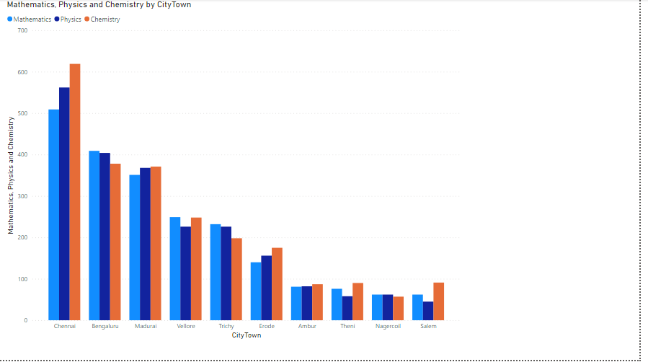
Did students from a particular city perform well?

Slide 8
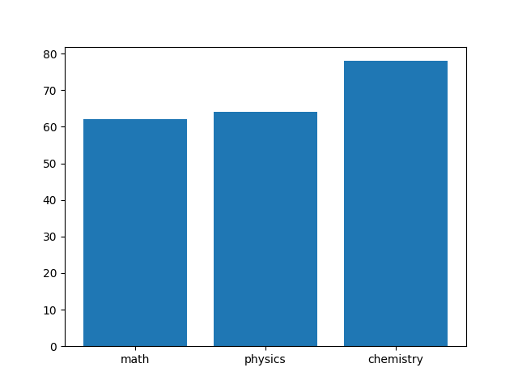
What is the size of the dataset? Size of the data set: 270
mode of mathematics 62
mode of Physics: 64
mode of Chemistry: 78

Slide 9
Average marks in Math: 72.36666666666666 Average marks in Physics 72.96666666666667 Average marks in Chemistry 77.13333333333334

Slide 10
What is the central value of different subjects? Centeral value of math: 73.0 Centeral value of Physics: 72.0 Centeral value of Chemistry: 79.5 Centeral value of Total 222.5

Slide 11
What is the variance of marks in different subjects and overall
Variance of Math 210.24022988505746
Variance of Physics 168.1712643678161
Variance of Chemistry 206.53333333333333
Variance of Total 871.3609195402299

Slide 12
Standard deviation of different subjects
standard deviation Mathematics: 14.499663095570789
standard deviation Physics: 12.968086380334459
standard deviation Chemistry: 14.371267631400277

Slide 13
Overall Findings
As per findings of report, most of the student comes from Chennai.
Chennai student’s performance is well in all the 3 subject, 1st one is chemistry 2nd is physics 3rd number is for maths.
Two student topped in Maths Rahul and Deepika which comes from Bengluru, from this we can conclude that Bengluru city is good for maths study.
Maximum student topped in physics subject:4, and all are from different cities.
Only two girl student are topper compared to four male student,also in overall marks in all the subjects girl student’s mark is less compared to male student, so we need to focus more on girls.

